Slide 1
Interoperability Platform Strategy for Health Plans
Arindam Dutta Choudhury

Slide 2
Agenda
Problem Statement
Vision
Market Drivers
Platform strategy
Solution Workflow
UX
Key Metrics
Differentiation

Slide 3

Interoperability Platform Strategy
Modernizing Prior Authorization & Care-Coordination​
For Health Plans (Commercial, MA, Medicaid)​
Assumptions: mid-large plans, legacy-heavy, value-based shift

Slide 4
Problem Statement
Fragmented Workflows (Portal, Fax, Phone):
Administrative tasks are siloed across disconnected channels, forcing staff to pivot between legacy portals, physical faxes, and manual phone calls.
Provider Friction & Delays:
Manual interactions create severe operational bottlenecks, delaying patient care and damaging payer-provider relationships.
Limited APIs and Interoperability:
Legacy utilization management and claims engines lack modern API capabilities, trapping critical clinical data in siloed systems.
Manual UM Processes Drive Cost & Poor Experience:
High-touch clinical reviews inflate operational overhead for health plans while keeping members in the dark regarding their care status.

Slide 5
Vision
Unified Interoperability Platform Enrolling Real-Time, API-First Prior Authorization:
Establishing a modern, FHIR-native gateway that transforms prior authorization from a lagging administrative burden into an instantaneous digital transaction.
Seamless Provider Experience:
Embedding directly into provider EHR systems to eliminate manual data re-entry and portal hopping.
Reduced Administrative Burden:
Automating routine intake, policy lookups, and routing to drastically lower operational costs for health plans.
Improved Member Outcomes:
Accelerating care delivery timelines to ensure members receive necessary treatments without unnecessary administrative delays.

Slide 6
Market Drivers
CMS Interoperability Mandates (FHIR APIs):
Strict federal regulations (like CMS-0057-F) legally require health plans to deploy standardized FHIR APIs for prior authorization and data exchange.
Provider Abrasion Reduction:
Accelerating market demand from health systems for payers to eliminate administrative friction and simplify authorization workflows.
Shift to Value-Based Care:
Increased industry focus on collaborative care requires real-time, transparent data sharing between payers and providers.
Cost Pressure on Health Plans:
Rising operational expenses necessitate a shift away from manual, resource-intensive utilization management toward automated workflows.

Slide 7
Platform Strategy
API-First Architecture (FHIR-Native):
Built from the ground up on modern HL7 FHIR (FHIR PAS) standards to ensure seamless, real-time data ingestion and compliance.
Modular Services (PA, UM, Care Mgmt):
A decoupled service layer allowing health plans to flexibly orchestrate prior authorization, utilization management, and care coordination.
Reduce EDI X12278 Footprint:
Create internal mapping to cater to existing IBs
Developer Ecosystem (Partners, Providers):
Exposing robust, well-documented APIs to allow health systems and third-party vendors to easily connect to our ecosystem.
Current State (Typical Payer)
278-based EDI transactions (batch-oriented)
Heavy manual workflows (fax, portal, call center)
Fragmented UM rules + inconsistent denial logic
Limited real-time visibility for providers
Weak data exchange across systems
SLA tracking not enforced systematically
Target State (CMS-Aligned PA Platform)
API-first (FHIR-based PAS + CRD + DTR)
Real-time decisioning and workflow orchestration
Fully automated documentation collection
Standardized clinical rules + explainable decisions
Cross-payer data exchange (continuity of care)
Transparent reporting + SLA compliance

Slide 8
Solution Workflow (End-to-End)
Provider Initiates Order in EHR (Triggering CRD): The clinician begins a treatment or medication order within their native EHR, automatically triggering an immediate, background query to the plan's policy engine.
Real-Time Eligibility, Coverage, & Policy Check: The platform instantly evaluates coverage rules via Da Vinci CRD, signaling to the provider whether prior authorization is required or if lower-cost alternatives exist.
Automated Documentation Gathering (DTR): If required, a dynamic checklist is surfaced directly within the EHR via Da Vinci DTR, auto-populating form templates using existing clinical records to prove medical necessity.
PA Submission via Standardized API (PAS): Once documentation is confirmed, the system packages the complete bundle and transmits the formal request electronically using the Da Vinci PAS API.
Instant Auto-Decisioning & Exception Routing: The health plan’s automated rules engine reviews the structured data payload to issue an immediate approval; if complex criteria are unmet, it escalates to clinical review with pre-mapped evidence.
Omnichannel Decision Delivery & Notification: The final determination is simultaneously pushed straight back into the provider's EHR interface and delivered digitally to the member via their secure plan app.
CRD - Coverage Requirements Discovery
DTR - Documentation Templates and Rules
PAS- Prior Authorization Support

Slide 9
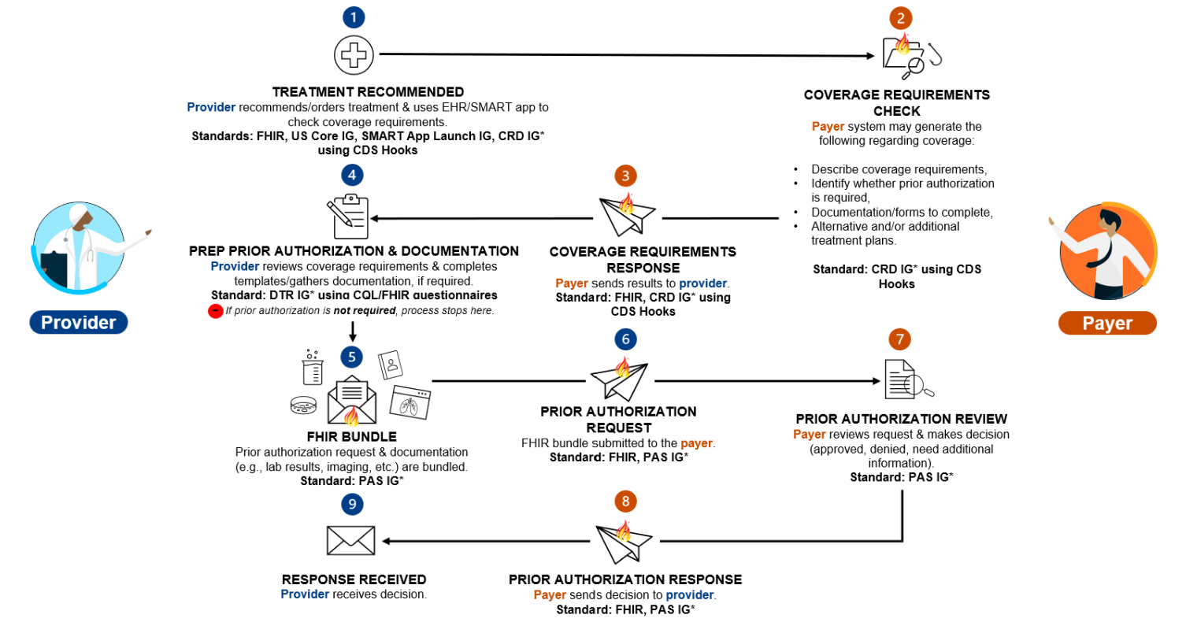
Solution Workflow (End-to-End)

Slide 10
User Experience
Providers (EHR-Integrated, No Portals/Fax):
Work entirely within their preferred software, achieving immediate visibility into coverage rules without external logins.
Health Plans (Automation + Visibility + Controls):
Gain a centralized dashboard to track automated workflows, manage exceptions, and configure clinical policies.
Members (Transparency, Real-Time Updates):
Experience faster access to care and clear, upfront visibility into their approval statuses and out-of-pocket responsibilities.

Slide 11
Prioritization Roadmap
Phase 1 (Point-of-Care Discovery - CRD/DTR):
Build the core FHIR-native gateway and launch real-time coverage lookup (CRD) and automated documentation checklists (DTR) directly within provider EHRs.
Phase 2 (Automated Submission & Intake - PAS):
Roll out standardized prior authorization submission APIs (PAS) to entirely eliminate legacy web portals and manual fax ingestion channels.
Phase 3 (Rules-Based Auto-Decisioning):
Implement the core deterministic policy engine to instantly auto-approve high-volume, highly compliant diagnostic and procedure codes.
Phase 4 (AI Clinical Review & Care Coordination):
Integrate advanced NLP to digest unstructured EHR chart notes for exception routing, while connecting authorization data straight into longitudinal care management.

Slide 12
Key Metrics
CRD-to-PAS Conversion Rate:
Monitor the percentage of automated policy lookups that cleanly progress to digital submissions without falling back to manual faxes.
Zero-Touch Auto-Approval Rate:
Measure the percentage of prior authorization requests instantly adjudicated by the rules engine without human intervention.
Provider Workflow Interruption (NPS):
Track clinician satisfaction by measuring time saved from eliminating external portal logins and manual data re-entry.
Average Adjudication Turnaround Time (TAT):
Shrink the administrative timeline from a multi-day standard down to mere seconds for automated rules.
Unit Cost Per Authorization:
Track operational overhead reductions achieved by shifting staff from manual triage to exception handling.

Slide 13
Differentiation
True FHIR-Native Architecture:
Avoids brittle API "facades" on top of legacy systems by adopting the official HL7 Da Vinci standard across the entire data lifecycle.
Seamless Closed-Loop EHR Integration:
Drives 100% provider adoption by delivering coverage rules and forms directly to the clinician before submission.
Deterministic Rules Paired with AI Assist:
Blends immediate, rule-based auto-approvals with intelligent clinical extraction to tackle complex, unstructured clinical documentation.
Unified UM, Claims, and Care Management:
Eradicates payer operational silos by ensuring the prior authorization perfectly matches the downstream claims adjudication engine.

Slide 14
Thank You
https://arindamduttachoudhury.lovable.app/

